Slide 1

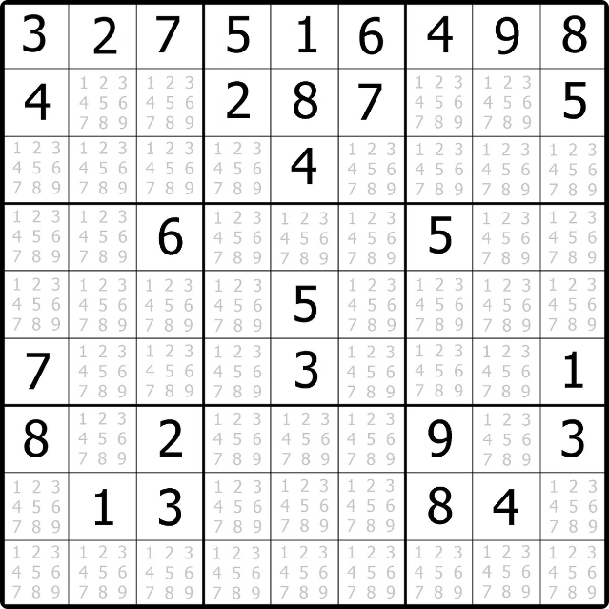
Introduction to Sudoku Solver Visualizer
The Sudoku Solver Visualizer is a powerful tool that helps users understand and solve Sudoku puzzles with ease. By providing a step-by-step visual representation of the solving process, this application aims to make the challenging game of Sudoku more accessible and enjoyable for players of all skill levels.
Navam Sharma 12216956

Slide 2

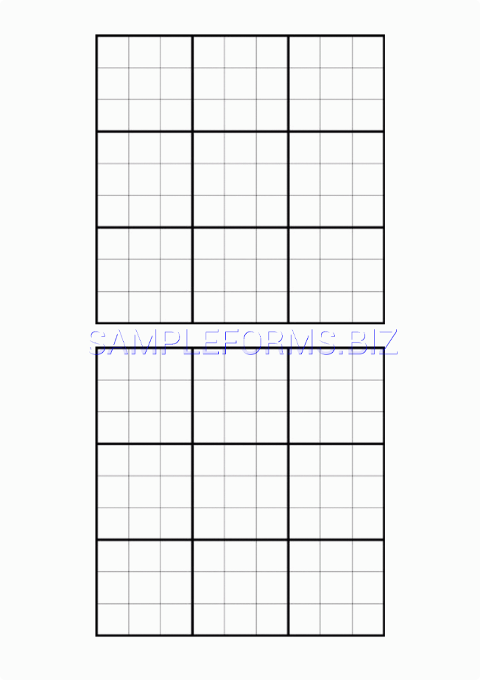
Overview of the Sudoku Puzzle
Grid Structure
Sudoku puzzles are based on a 9x9 grid, which is further divided into 9 smaller 3x3 sub-grids.
Objective
The goal is to fill the grid with digits from 1 to 9, ensuring that each row, column, and 3x3 sub-grid contains all the digits without any repetition.
Difficulty Levels
Sudoku puzzles come in varying difficulty levels, from easy to extremely challenging, providing a engaging experience for players of all skill levels.

Slide 3
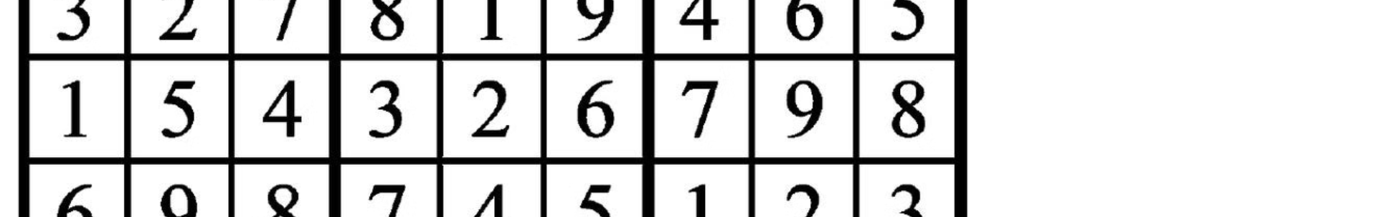
Importance of Sudoku Solver Visualizer
Enhance Understanding
1
The visualizer helps players understand the logical steps involved in solving Sudoku puzzles, making the process more transparent and educational.
2
Improve Solving Skills
By observing the solver's strategies, players can learn and apply effective techniques to improve their own Sudoku solving skills.
Boost Confidence
3
The step-by-step visualization and successful puzzle completion can bolster players' confidence and encourage them to tackle more challenging Sudoku puzzles.

Slide 4
Key Features of the Visualizer
Interactive Grid
Solving Techniques
Customizable Settings
The visualizer presents the Sudoku grid in an interactive format, allowing users to input their own puzzle or start with a pre-generated one.
The visualizer demonstrates a variety of solving techniques, such as logical deduction, elimination, and pattern recognition, to guide users through the solving process.
Users can adjust the visualizer's settings, such as speed, level of detail, and feedback options, to tailor the experience to their preferences.

Slide 5

Algorithms and Techniques Used
1
Backtracking Algorithm
2
Constraint Propagation
The core of the solver, this algorithm systematically explores all possible solutions to find the correct one.
This technique analyzes the grid to identify and eliminate invalid candidates, reducing the search space.
3
Heuristic Optimization
4
Visualization Techniques
Advanced heuristics are employed to enhance the solver's efficiency and speed, making it more robust.
The visualizer utilizes various visual cues, animations, and UI elements to provide a seamless and engaging user experience.

Slide 6


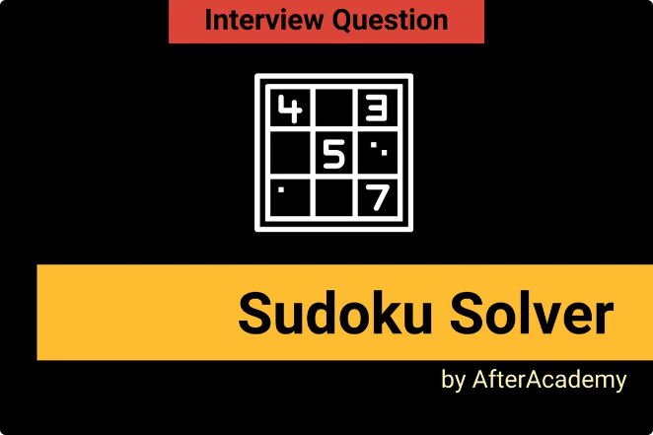



Step-by-Step Walkthrough of the Solver
Input Puzzle
Users can input a Sudoku puzzle by filling the grid or selecting a pre-generated one.
Analyze Grid
The solver examines the grid, identifying valid candidates and applying constraint propagation.
Apply Algorithms
The solver utilizes backtracking and heuristic optimization to systematically explore and find the solution.
Visualize Steps
The visualizer animates and highlights each step of the solving process, providing a clear understanding.

Slide 7





Visualization and User Interface
Interactive Grid
Step-by-Step Visualization
Feedback and Guidance
Customizable Settings
The Sudoku grid is displayed in a clear and intuitive format, allowing users to interact with the puzzle.
The solver's progress is animated, highlighting each move and the logic behind it.
The visualizer provides real-time feedback and guidance to help users understand the solving process.
Users can adjust the visualizer's speed, level of detail, and other preferences to suit their needs.

Slide 8

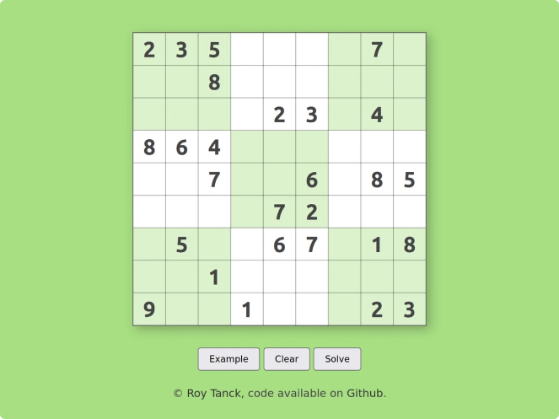
Conclusion and Future Enhancements
1
Comprehensive Solution
The Sudoku Solver Visualizer provides a comprehensive and engaging solution for understanding and mastering Sudoku puzzles.
2
Continuous Improvement
The project team is committed to regularly updating and enhancing the visualizer based on user feedback and emerging trends.
3
Expanded Functionality
Future versions may include features like puzzle generation, difficulty level adjustment, and integration with mobile platforms.
4
Broader Impact
The Sudoku Solver Visualizer has the potential to inspire and educate users, promoting logical thinking and problem-solving skills.

Slide 9
THANK YOU

